Slide 1

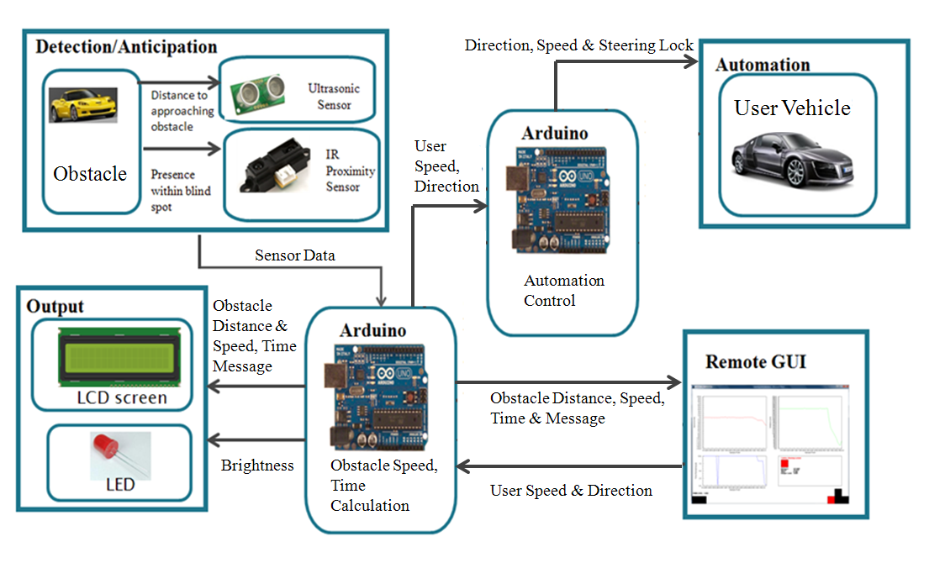
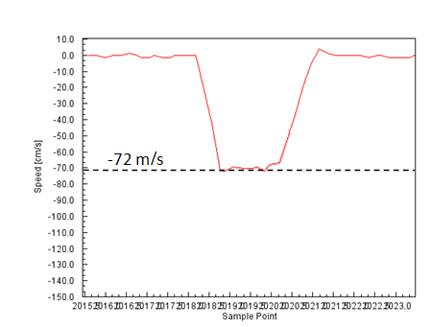
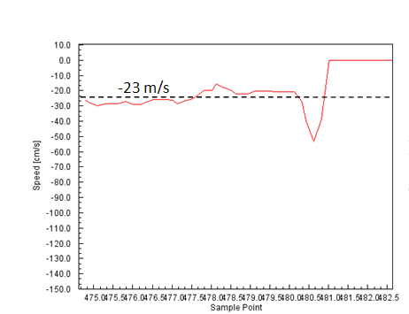
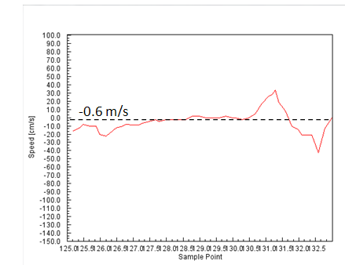
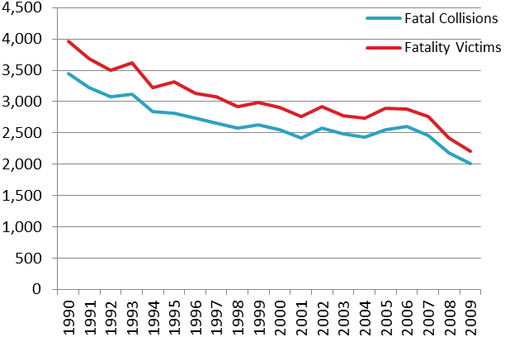
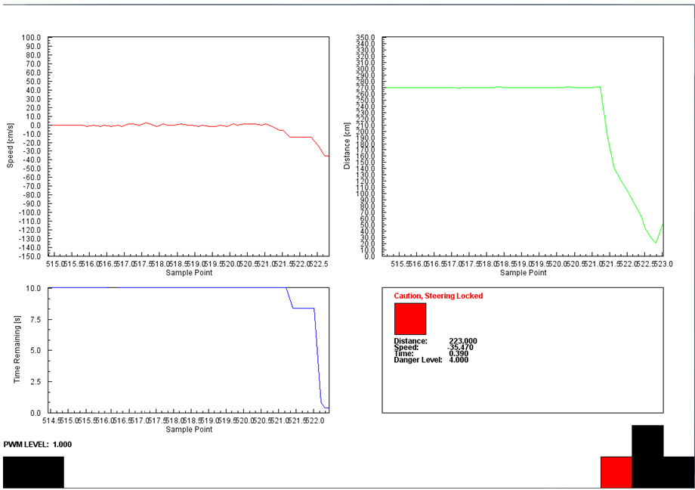
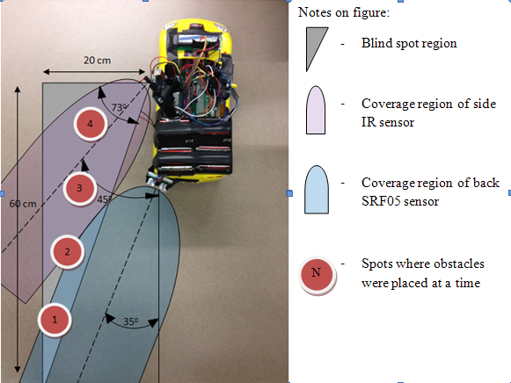
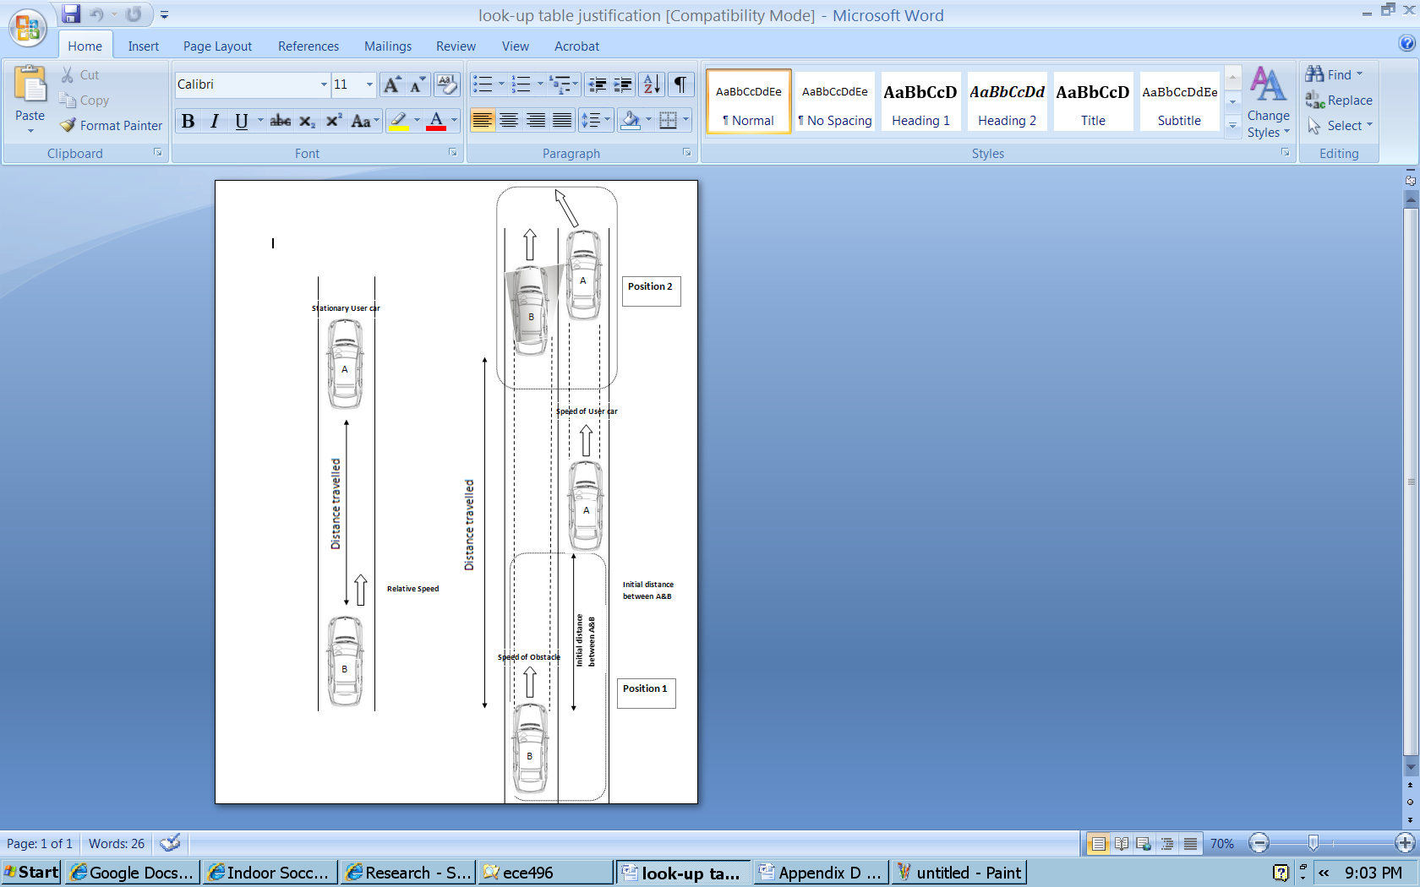
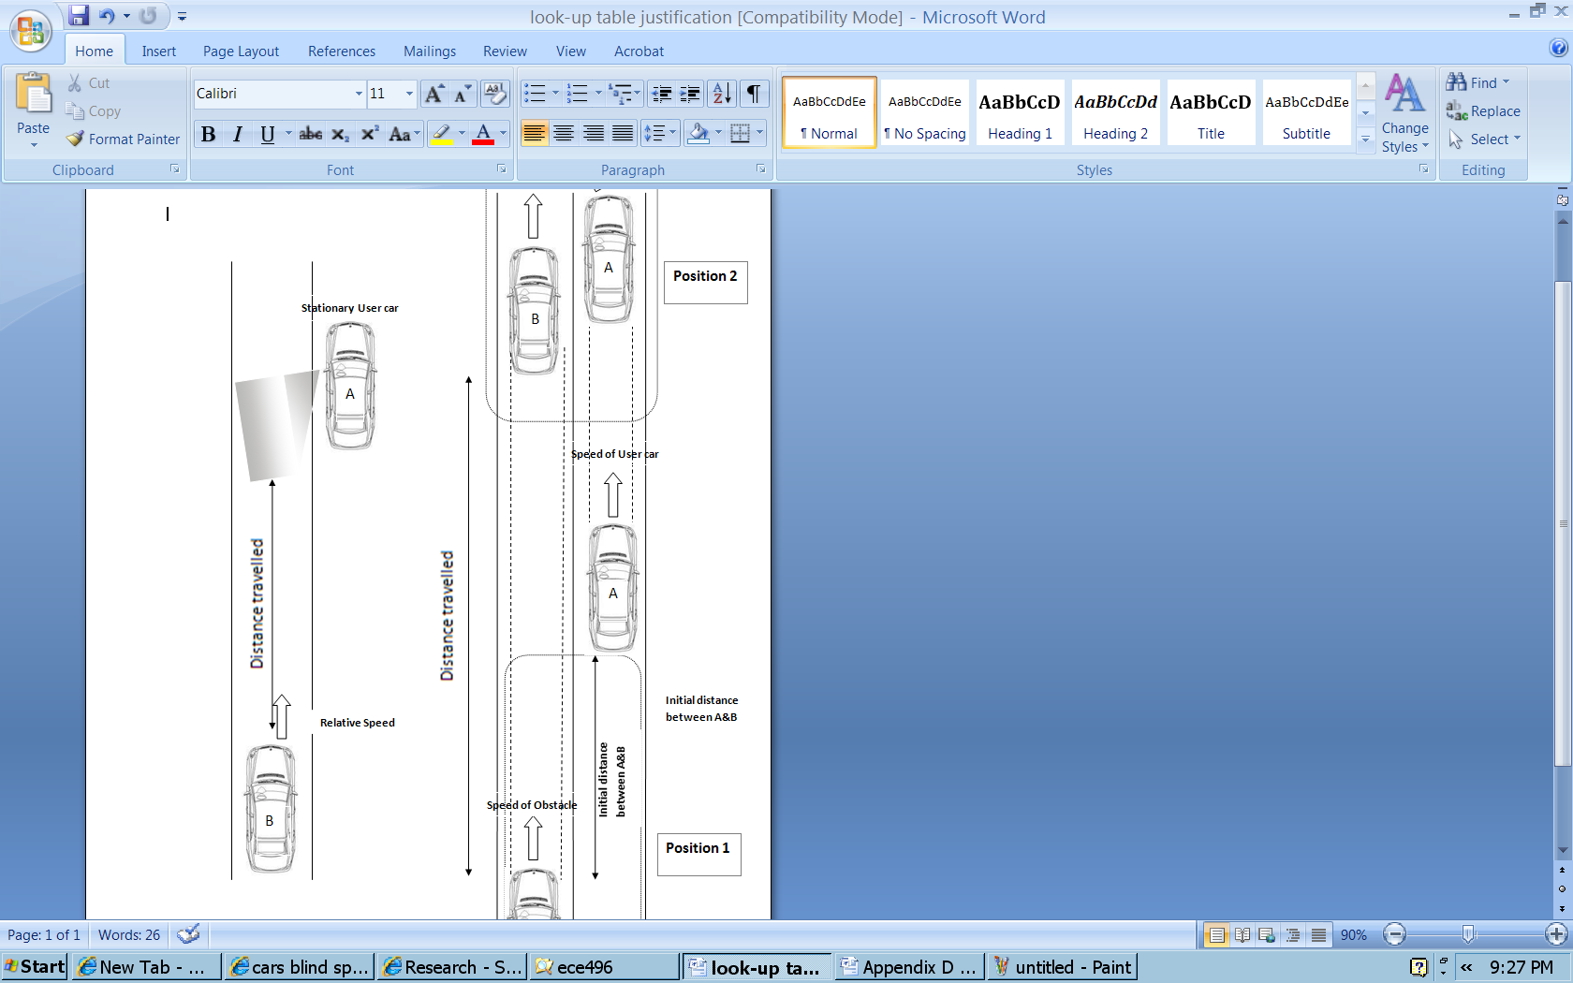
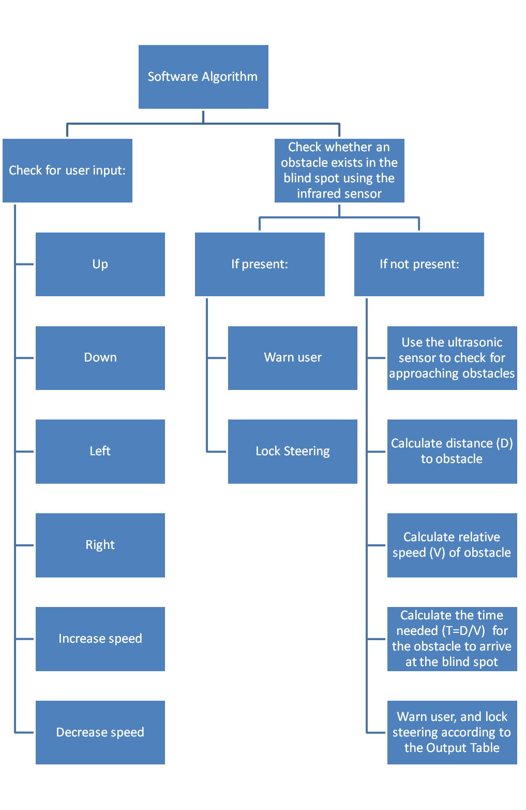
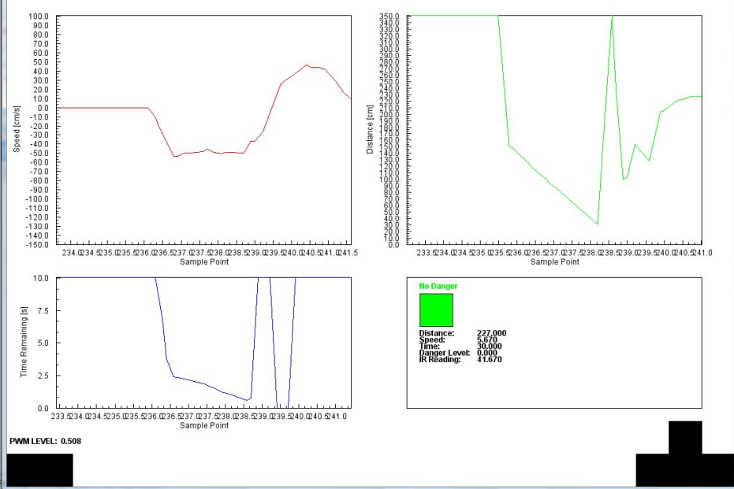
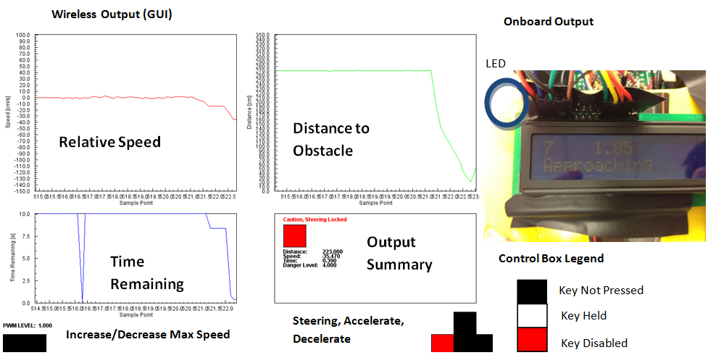
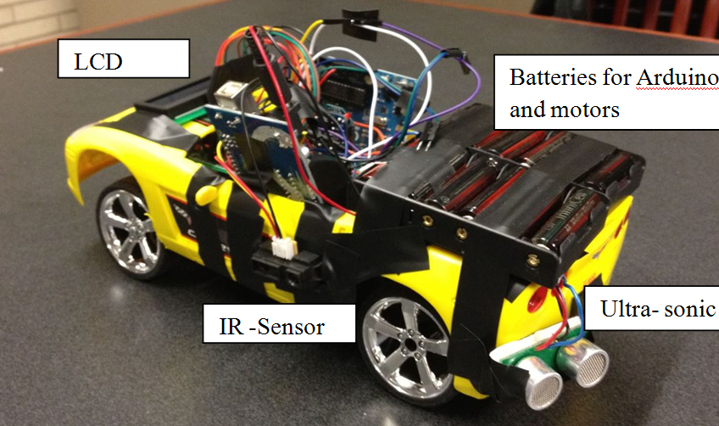
Vehicle Blind Spot Assist # 2011317
Hani Hadidi, Valikhan Kuparov, Tanzim Mokammel
Department of Electrical and Computer Engineering
University of Toronto
Motivation:
Accident during lane changes are common due to driver’s not checking their Blind Spots
Companies such as BMW, Volvo etc have implemented blind spot assist devices on their models, however, universal devices are not widely available
Accident rates are decreasing as safety technology becomes more of a concern, but there’s room for improvement
Test Results
System Level Overview
Speed Tests
Distance Tests
 | Measured Relative speed, (v_{obstacle} – v_{user}), cm/s | Calculated Relative Speeds, cm/s | % Error
User vehicle PWM = 41% | 105.86 – 30.08 = 75.78 | 72.00 | 5.20
User vehicle PWM=51% | 105.86 – 81.72 = 24.14 | 23.00 | 4.90
User vehicle PWM=61% | 105.86 – 106.2 = -0.60 | -0.6 | 0.00
Ultrasonic
1
Actual distance (cm) | Test Result (cm) | Error, %
5 | 5 | 0.00
1 | 101 | 1.00
2 | 201 | 0.50
3 | 300 | 0.00
2
3
Infrared
2
3
Actual Distance (cm) | Test Result | Error, %
7.00 | 7.20 | 2.70
12.00 | 12.08 | 0.60
20.00 | 20.26 | 1.30
1
Steering Lock Test
Blind Spot Coverage Test
Figure 5: Fatal Collisions and Fatality Victims (1990-2009)
Proposed Concept
Software Algorithm
Danger Levels and Output Table
Situation | Sensor Involved | Time Left [s] | Danger Level | LCD Screen Output | LED Output | Steering Locked
No Danger | Primary | t > 15 | 0 | Distance to obstacle, “No Danger” | Off | N
Obstacle Approaching | Primary | 11 < t < 15 | 1 | Distance to obstacle, relative speed, “Obstacle Approaching” | Brightness from 0% to 78%, depending on increasing distance | N
Obstacle Approaching | Primary | 6 < t < 11 | 2 |  |  | N
Obstacle Approaching | Primary | 3 < t < 6 | 3 |  |  | N
Obstacle Very Near | Primary | t < 3 | 4 | Distance to obstacle, relative speed, “Caution” | Fully On | N
Obstacle at Blind Spot | Secondary | t ≤ 0 | 5 | “Danger, Check Blind Spot” | Fully On | Y
System Level Test
System Level Test
Objective: | Device should accurately determine danger levels, and lock the steering accordingly
Date: | March 20th, 2012
Location: | 3rd floor hall, Bahen Center
Test Setup | Obstacle car and user car run with different known speeds Relative speed, distance and remaining time plots are observed For cases where time remaining was below the threshold, or an obstacle was already present in the blind spot, successful steering lock was observed
Feedback and Observations | Distance, Speed and time are calculated accurately; user is unable to collide into obstacle as the steering is locked when time remaining falls below the specified threshold
Conclusions
Project Goal:
Assist in accident prevention through a device that will help users identify and anticipate obstacles in their vehicle’s blind spot
Provide an additional level of accident prevention through the implementation of an automated steering lock feature based on relative danger levels
Acknowledgements
Micah Stickel
Ross Gillett
Khoman Phang
Lawrence Chan
Mike Mehrniz
User Output
Physical Design

